Slide 1
Evaluating the Community Effects of LLINs Across Transmission Intensities
Zenabu Suboi
19th May, 2026

Slide 2
Agenda
Topic
Introduction
Methods
Results
Key messages
Recommendations

Slide 3
Introduction

Slide 4
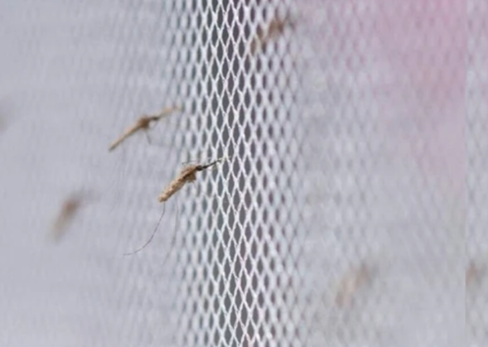
LLIN effectiveness
Long lasting insecticidal nets (LLINs) have been attributed with averting 663 million clinical cases from 2000 – 2015
effectiveness of LLINs arises from two complementary mechanisms:
physical prevention of mosquito bites
insecticidal action that kills or deters mosquitoes
Protecting both users and non-users
Source: https://link.springer.com/article/10.1186/s12936-020-03321-6

Slide 5
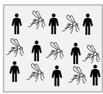
The concept of community protection
LLINs offer different benefits for users and non-users within a population
No LLIN use

Slide 6
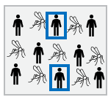
The concept of community protection
LLINs offer different benefits for users and non-users within a population
net-users receive personal protection
No LLIN use
X% LLIN use

Slide 7
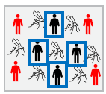
The concept of community protection
LLINs offer different benefits for users and non-users within a population
net-users receive personal protection
both users and non-users benefit from reduced transmission
reduced mosquito density, lifespan, and proportion of infectious mosquitoes
This concept has been established as community (indirect) protection
No LLIN use
X% LLIN use
Increased LLIN use
Source: Adapted from Unwin et. al ,2023

Slide 8
Evidence of community protection
Evidence from both empirical (Hawley et al., 2003 , Lukole et al., 2025) and modelling studies (Killeen et al., 2007, Unwin et al., 2023)
These evidences indicate that
vary by spatial scale and local coverage levels (Hawley et al., 2003)
depends on proximity with treated net users (Hawley et al., 2003)
heterogeneous and sensitive to local transmission dynamics, intervention coverage, and vector ecology (Killeen et al. 2007, Unwin et al, 2023)
present in settings with pyrethroid resistance depending on net type (Lukole, et al., 2025, Unwin et al, 2023)
Notes:
In western kenya –
Modeling evidence – CL
Unwin et al
Multi-country DHS analysis

Slide 9
What this study focuses on
the magnitude and robustness of community protection remain incompletely evaluated across epidemiological settings
we use OpenMalaria to quantify the effects of LLIN usage on LLIN users and non-users across a wide range of transmission intensities and effective usage levels.

Slide 10
Methods

Slide 11
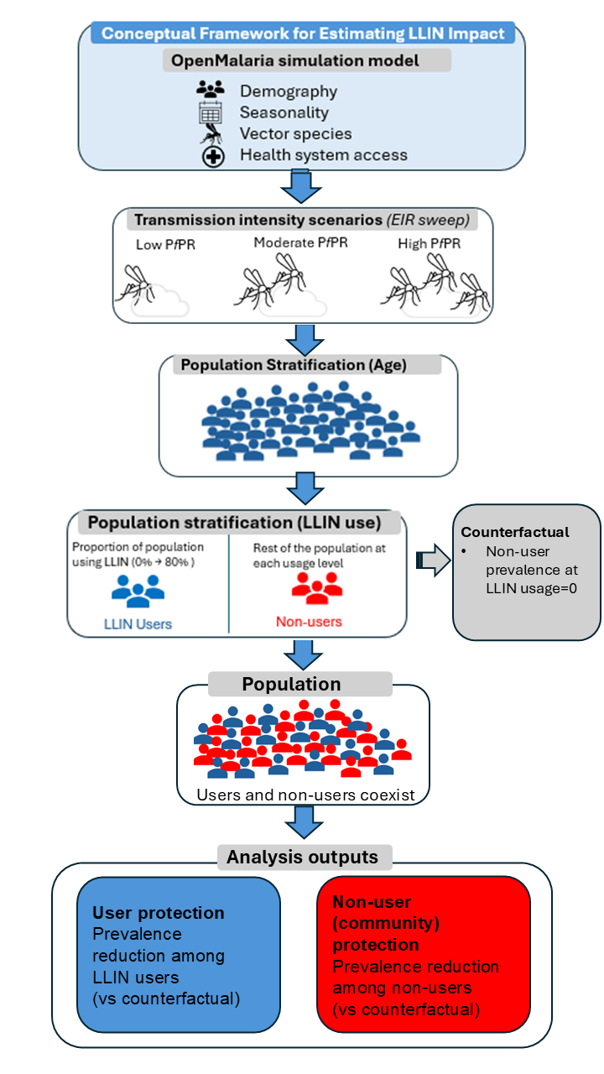
Methods
Ghana context

Slide 12
Methods
EIR: 1-100
Low PfPR: [< 10%]
Moderate PfPR : [13%-34%]
High PfPR : [36%-46%]

Slide 13
Methods
EIR: 1-100
Low PfPR: [< 10%]
Moderate PfPR : [13%-34%]
High PfPR : [36%-46%]
Simulated pop size: 50’000
Age groups: 0-100

Slide 14
Methods
EIR: 1-100
Low PfPR: [< 10%]
Moderate PfPR : [13%-34%]
High PfPR : [36%-46%]
Simulated pop size: 50’000
Age groups: 0-100
Net Characteristics
Type - IG2
Half-life – 2.4
Effective usage: 0-80%
Efficacy based on CIV EHT – (Assenga et al., 2025)

Slide 15
Methods
EIR: 1-100
Low PfPR: [< 10%]
Moderate PfPR : [13%-34%]
High PfPR : [36%-46%]
Simulated pop size: 50’000
Age groups: 0-100
Net Characteristics
Type - IG2
Half-life – 2.4
Effective usage: 0-80%
Efficacy based on CIV EHT – (Assenga et al., 2025)
Interventions Implemented
CM: 2000-2031
IG2 net: 2023, 2026, 2029

Slide 16
Methods
EIR: 1-100
Low PfPR: [< 10%]
Moderate PfPR : [13%-34%]
High PfPR : [36%-46%]
Simulated pop size: 50’000
Age groups: 0-100
Net Characteristics
Type - IG2
Half-life – 2.4
Effective usage: 0-80%
Efficacy based on CIV EHT – (Assenga et al., 2025)
Interventions Implemented
CM: 2000-2031
IG2 net: 2023, 2026, 2029

Slide 17
Results

Slide 18
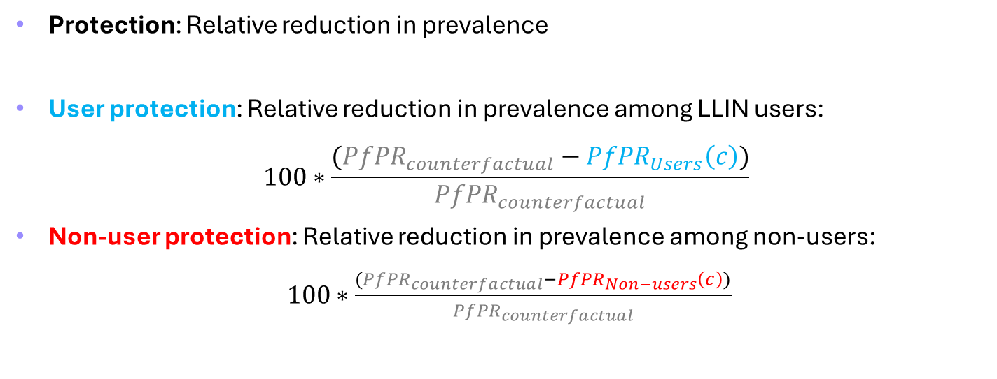
Impact definitions and estimates: Relative reduction in prevalence
Protection: Relative reduction in prevalence
User protection: Relative reduction in prevalence among LLIN users:
$$100∗\frac{({PfPR}_{counterfactual}−{PfPR}_{Users}\left(c\right))}{{PfPR}_{counterfactual}}$$
Non-user protection: Relative reduction in prevalence among non-users:
$100∗\frac{({PfPR}_{counterfactual}−{PfPR}_{Non−users}\left(c\right))}{{PfPR}_{counterfactual}}$
c =effective usage
Notes:
Figure 2 – what fraction of the original burden has been removed in both sub-populations across transmission intensities? – is there a plateau?
Overall protection: Relative reduction in prevalence among the overall population: $100∗\frac{({PfPR}_{x,baseline}−{PfPR}_{x,Population}\left(c\right))}{{PfPR}_{x,baseline}}$

Slide 19
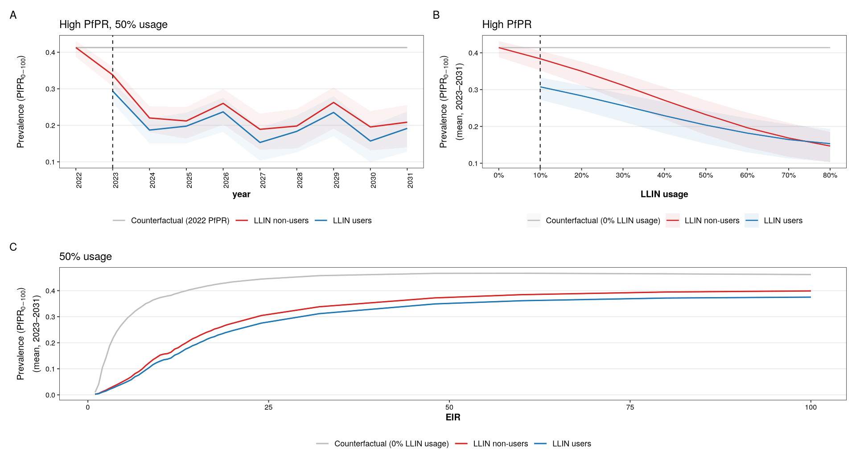
community protection varies with usage and transmission intensity but not with time

Slide 20
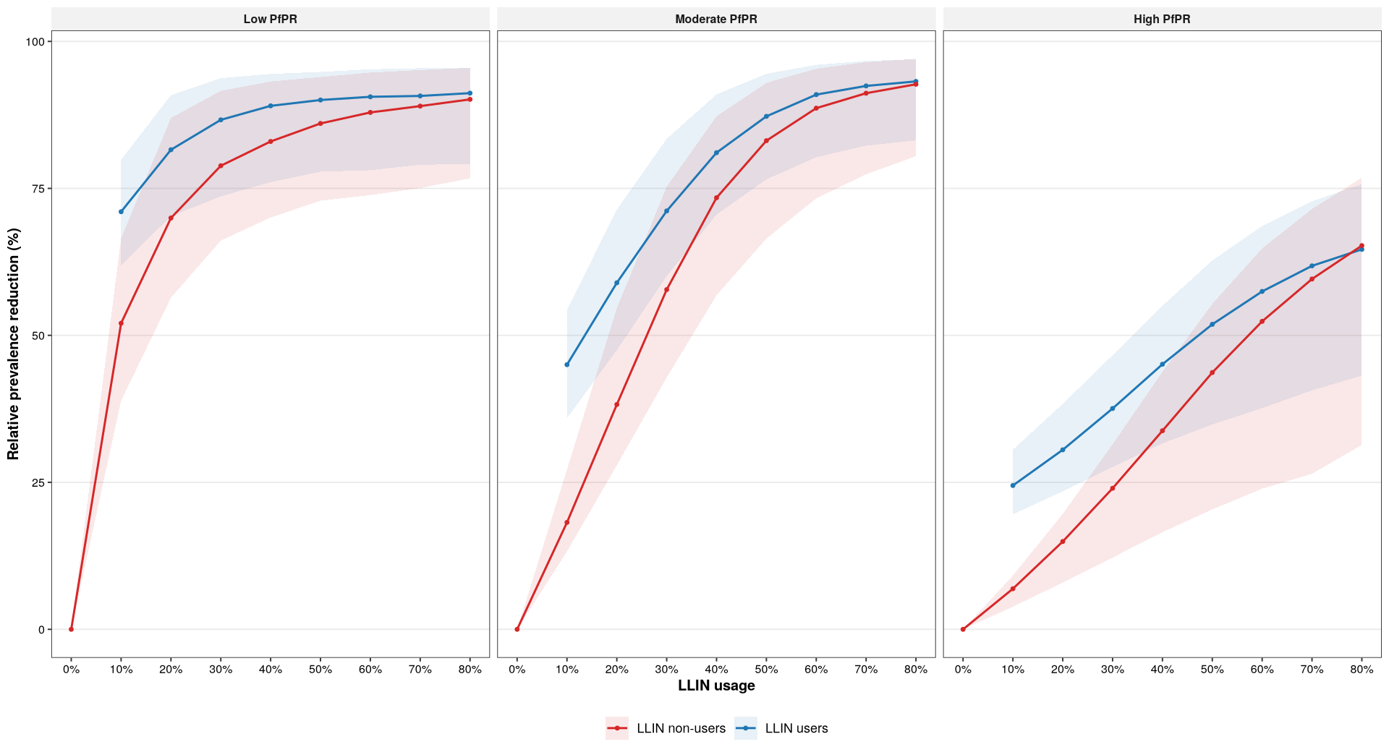
community protection plateaus with usage in low and moderate but not in high transmission setting
Notes:
Fraction of the original burden removed

Slide 21
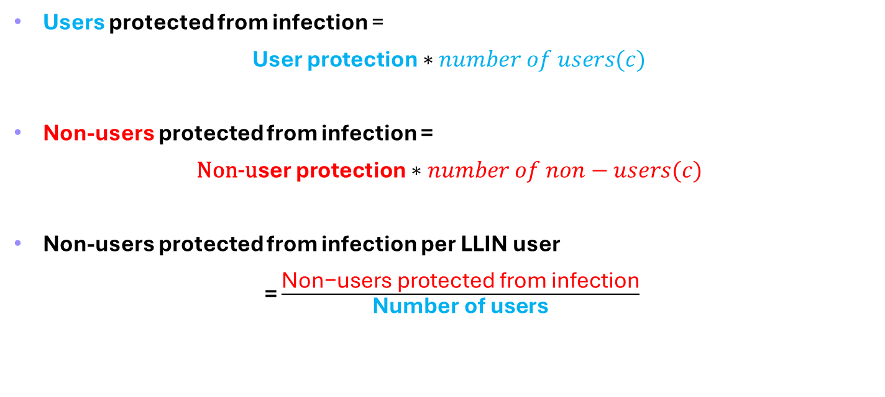
Impact definitions and estimates: Users and Non-users protected from infection
Users protected from infection =
$\text{User} \text{protection}∗number of users(c)$
Non-users protected from infection =
$\text{N}\text{on}\text{−}\text{u}\text{ser} \text{protection}∗number of non−users(c)$
Non-users protected from infection per LLIN user
= $\frac{\text{Non}\text{−}\text{users} \text{protected} \text{from} \text{infection}}{\text{N}\text{umber} \text{of} \text{users}}$
c =effective usage
Notes:
Figures 3, 4, 5 – For any given number of users protected with nets, how many users and non-users were actually protected from infection?
- When does community protection compensate for low or moderate coverage?

Slide 22
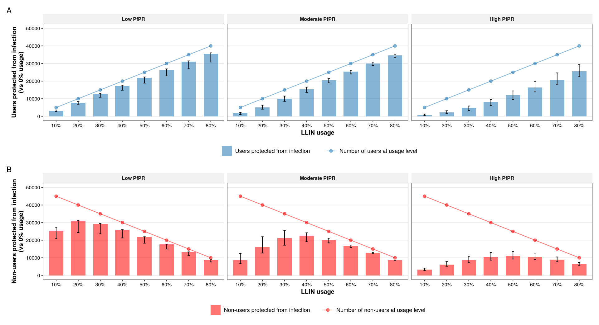
Non-users benefit maximally from community protection at ~50% usage in moderate and high PfPR, and ~20% in low

Slide 23
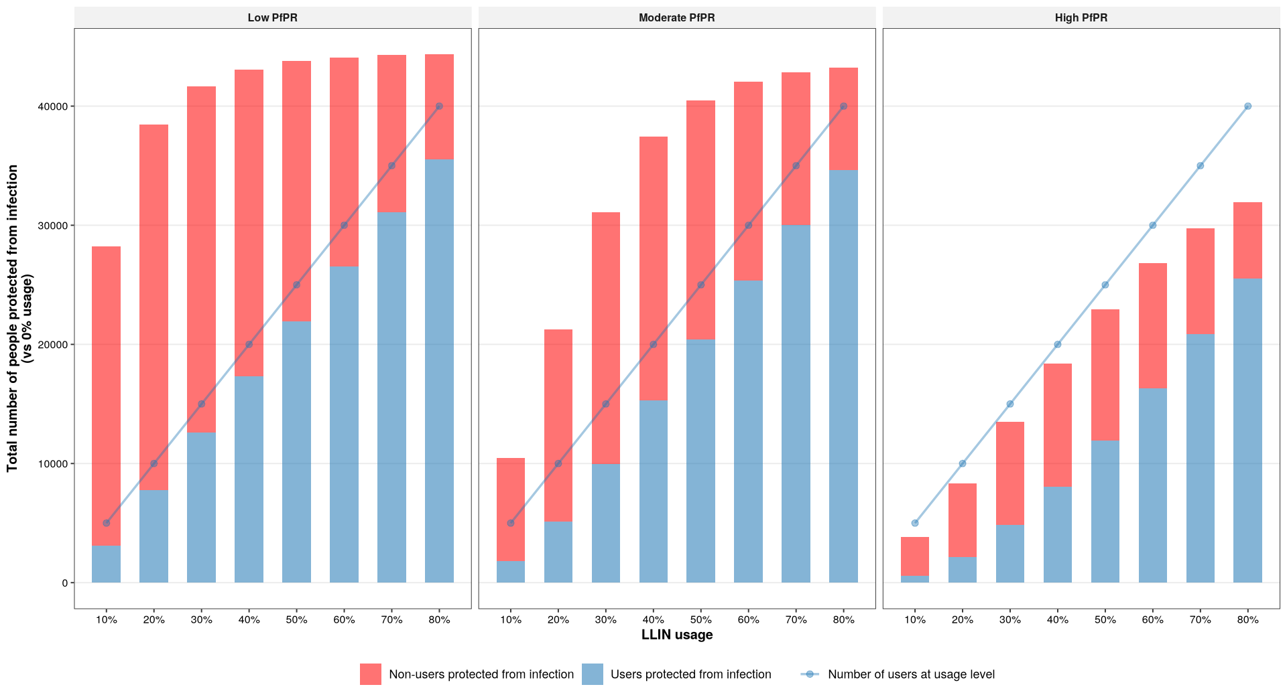
community protection compensates for moderate coverage (~40%-60%) in low and moderate transmission

Slide 24
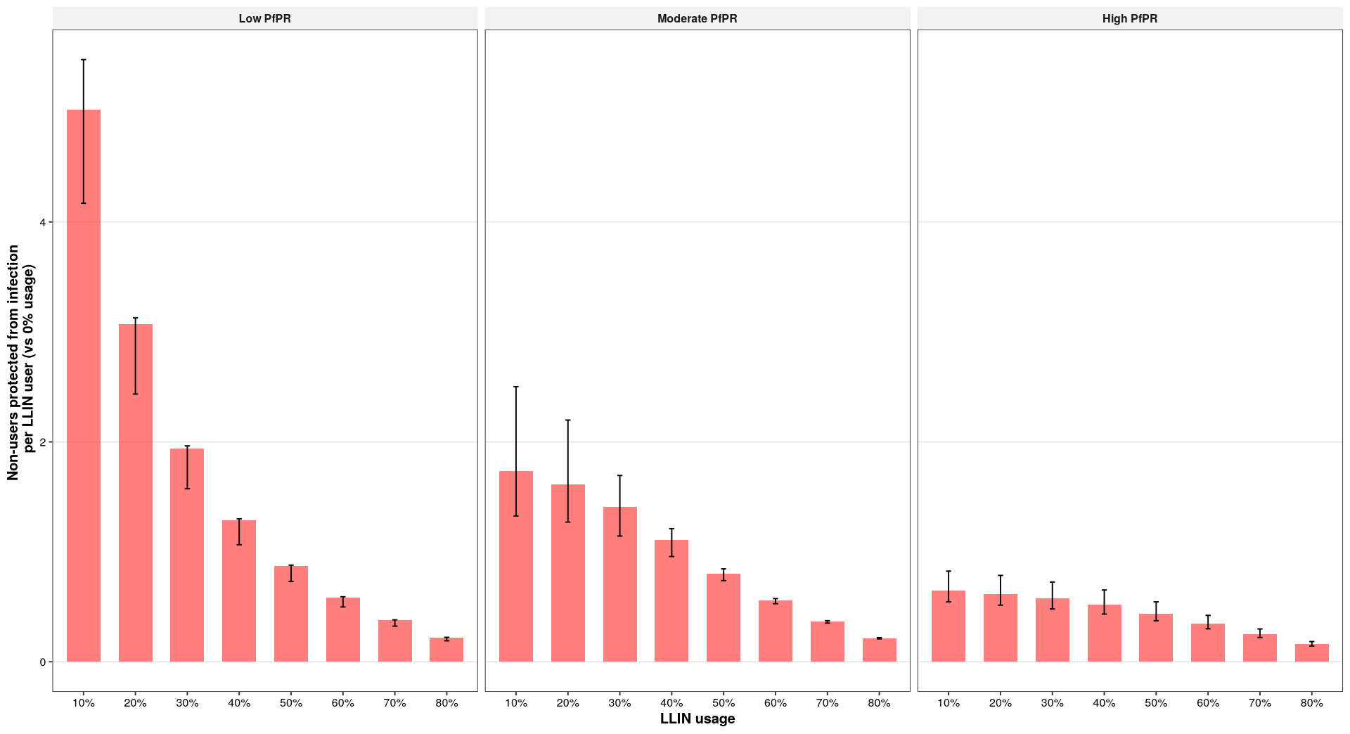
Non-users protected from infection per LLIN user decreases with increasing usage across all transmission intensities

Slide 25

Comparison with literature
Moderate to high transmission setting - Tanzania
Chlorphenapyr arm (IG2) provides protection among non-users with cluster usage below 40% (Lukole et al., 2025)
high transmission setting – Western Kenya
at least 35% community coverage of nets is required to protect non-users (Osuke et al., 2012)
modeling
35–65% would be needed to achieve community-wide benefits (Killeen et al., 2007)
one LLIN user provides some protection to non-users (Unwin et al., 2023)
Notes:
Fraction of the original burden removed

Slide 26
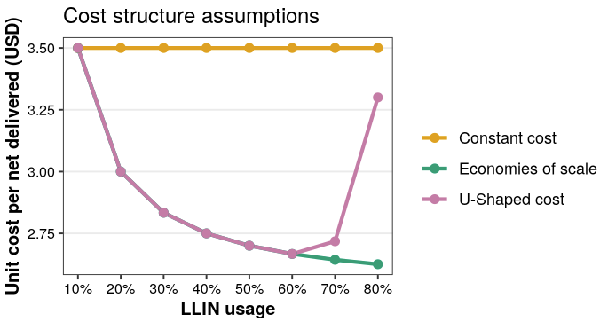
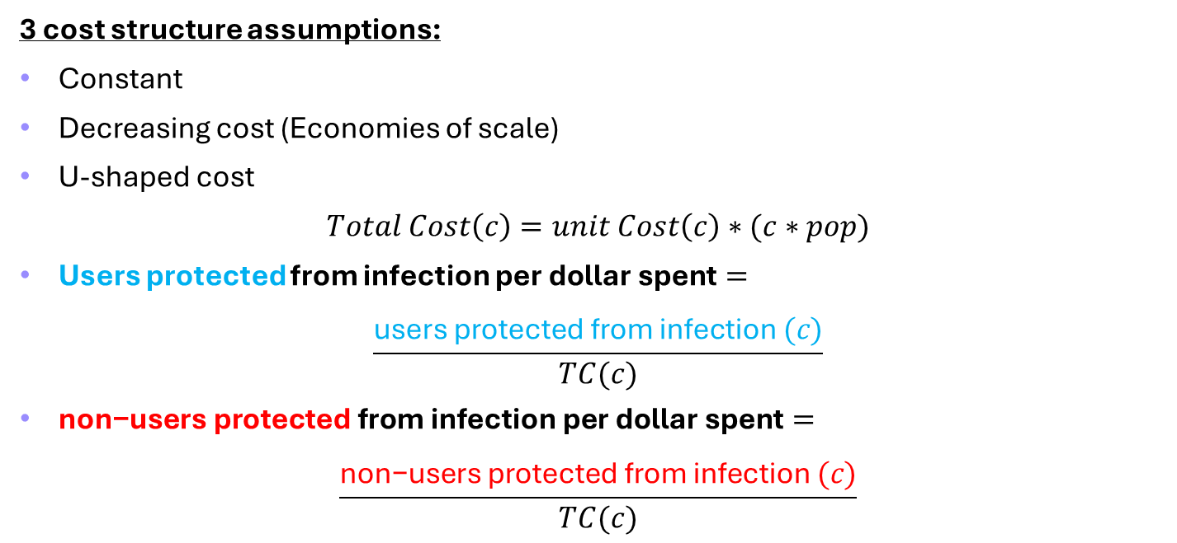
Impact definitions and estimates: cost-effectiveness
3 cost structure assumptions:
Constant
Decreasing cost (Economies of scale)
U-shaped cost
$$Total Cost\left(c\right)=unit Cost\left(c\right)∗(c∗pop)$$
Users protected from infection $\text{per} \text{dollar} \text{spent}=$
$$\frac{\text{users} \text{protected} \text{from} \text{infection} (c)}{TC(c)}$$
$\text{non}\text{−}\text{users} \text{protected} \text{from} \text{infection} \text{per} \text{dollar} \text{spent}=$
$$\frac{\text{non}\text{−}\text{users} \text{protected} \text{from} \text{infection} (c)}{TC(c)}$$
c =effective usage
Notes:
Figure 6 – how does the protection from infection in both sub-populations vary under different cost structure assumptions?

Slide 27
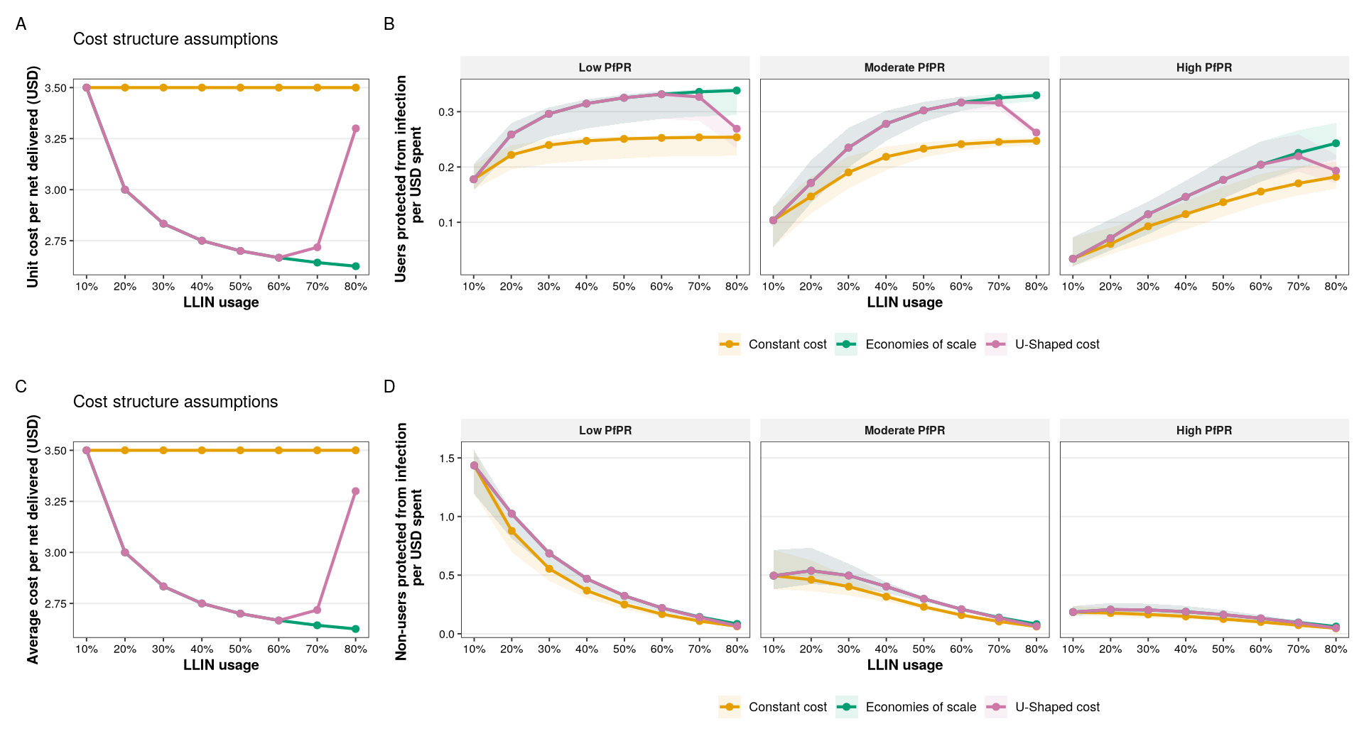
LLINs are most cost-effective in low and moderate PfPR setting regardless of the cost structure or usage status

Slide 28
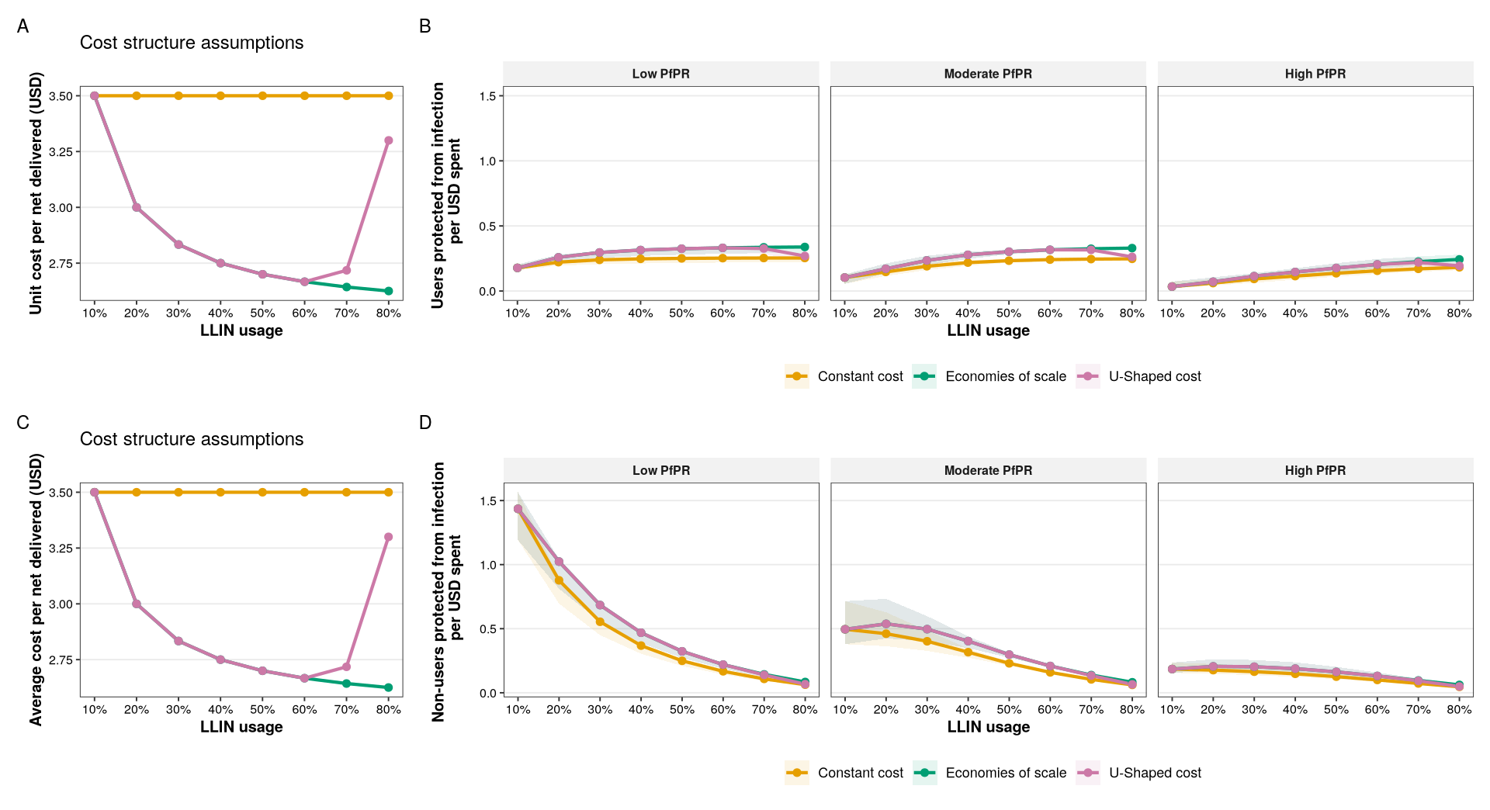
LLINs are most cost-effective in moderate PfPR setting regardless of the cost structure or usage status

Slide 29
Key messages
Community protection varies with usage and transmission intensity, but not with time
Community protection plateaus in low and moderate but not in high transmission intensity
Non-users benefit maximally from community protection at ~50% usage in moderate and high PfPR, and at ~20% in low

Slide 30
Key messages
Community protection compensates for low (~30%) and moderate (~50%) usage in low and moderate transmission intensities respectively
Non-users protected from infection per LLIN user decreases with increasing usage across all transmission intensities
LLINs are most cost-effective in low and moderate transmission settings (with moderate effective usage), irrespective of the cost structure or LLIN usage status

Slide 31
Recommendations:
low to moderate effective usage ~(30% - 40%) is recommended in low transmission
moderate effective usage (~50% - 60%) is recommended in moderate transmission
In high transmission, high effective usage is recommended as gains continue to increase with increasing coverage (no plateau)

Slide 32
Recommendations:
LLINs should be targeted to low and transmission intensities where they are most cost-effective with less resources
LLINs should be complimented with other malaria control interventions, especially in high transmission

Slide 33
Limitations
The model simplifies reality, and may not fully capture all sources of heterogeneity present in real-world contexts, including:
variations in human behaviour
Activity patterns of vectors
durability of nets
intervention adherence
spatial heterogeneity
We assume that users and non-users are in close enough proximity
The effect of the spread of pyrethroid resistance was not considered here which could alter the LLIN effects estimated
Notes:
Fraction of the original burden removed

Slide 34
Thank you for your attention
zenabu.suboi@swisstph.ch
Supervisors: Christian Selinger, Emilie Pothin

